Slide 1
What is..
Understanding CTS Proles and Modifying CTS Profiles
SAGARV

Slide 2
What is CTS..
Content Transformation Services is a suite of Documentum server side products that provide transformations and analysis for all content.
The home for all server side transformations.

Slide 3
CTS Products Over view
CTS – Content Transformation Services is a framework for Documentum server-side products that provide transformations and analysis for content. Various CTS products:
  DTS - Document Transformation Services (Formerly CRS, Auto-Render Pro)
  ADTS - Advanced Document Transformation Services
  MTS - Media Transformation Services (Formerly Media Services)
  AVTS – Audio Video Transformation Services
  MITS – Medical Imaging Transformation Services
Notes:
Title
Month Year

Slide 4
Basic view of CTS Products
5 CTS Products !
Highlights:
Each Product provides different transformation and analysis features for different content formats
Products can be deployed individually or all at once
All products utilize a common framework
Fully extensible through Software Development Kit (SDK) and invoked through common API
Software Development Kit
Document Transformation Services (DTS)
Advanced Document Transformation Services (ADTS)
Audio/Video Transformation Services (AVTS)
Common Architecture
Media Transformation Services (MTS)
Medical Imaging Transformation Services (MITS)
Notes:
Title
Month Year

Slide 5
Understanding Profiles..
How CTS Transforms renditions ??
Each product in the Content Transformation Services suite offers specific transformation capabilities for a particular set of source formats.
For example: Document Transformation Services transforms common business document formats such as Microsoft Word, HTML, and PDF, whereas Media Transformation Services transforms a variety of image formats such as GIF and JPEG like so on...
Within the CTS framework(SDK), underlying applications (known as plug-ins) are used to identify, process, and transform source files. Content Transformation Services products are shipped with sets of predefined profiles that provide a simple method for an application to access these plug-ins.

Slide 6
Understanding Profiles..( 2 of 2)
Profiles are XML files that an application passes to the transformation server when requesting a specific functionality.
There are 2 types of Profiles..
1) System Profiles
2) User Profiles
(contd..)

Slide 7
System Profiles..
System Profiles:
System profiles are only used internally by Content Transformation Services, and are not exposed through the client application.
Generally speaking, the system profiles specify the source and target formats to be processed, and invoke the necessary command-line files.
In simple.. System profiles are invoked silently, either through registration (import or check in of files) or by other profiles, to control the processing of content
Example.. When files are imported or checked in to the repository, they are first processed by the register profile. This process is called registration. The register profile acts like a gatekeeper, by directing the way in which imported content is handled..

Slide 8
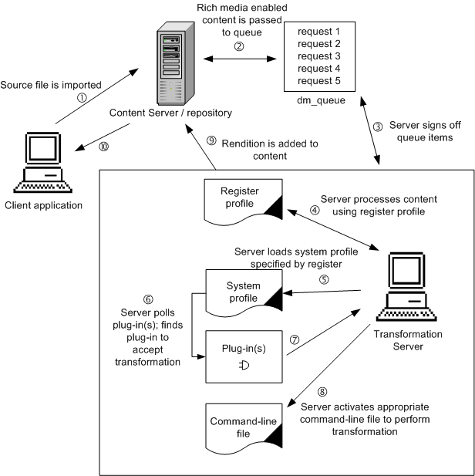
Illustration of Register Profile
Lets see the process how Register Profile is invoked on Importing file
Notes:
Title
Month Year

Slide 9
Register Profile
What is Register Profile and what it Does??
The register profile controls the processing of rich media-enabled content that is imported to the repository, Depending on the Content Transformation Services
product's) installed.
The register profile is the most commonly used system profile. It is unlike any other system profile, because it does not actually perform a transformation. It directs the transformation server to the appropriate system transformation profile.
Whenever rich media-enabled content is imported or checked in, the transformation server accesses the register profile and it directs to appropriate system transformation profile.
Contd…
Notes:
Title
Month Year

Slide 10
Register Profile (2 of 2)
Functionalities of register Profile
The register profile provides the following information to the server.
-The <Formats> section contains all the formats supported by the Content
Transformation Services product to generate default renditions.
Source and target formats are the same in the register profile.
- The <InnerProfile> path specifies which transformation profile the
server should load.If you want to enable additional default renditions,
you must add an <InnerProfile>tag to the register profile for these
additional capabilities.
Notes:
Title
Month Year

Slide 11
User Profiles (2nd type)
User profiles process transformations requested by users through a WDK application such as Digital Asset Manager (DAM) or Web Publisher.
These types of transformations give users the flexibility to choose specific files in the repository, and specify parameters (such as header and footer information, watermarks, job options, and security settings) during the transformation.
When the user invokes a parameterized profile, the user is prompted to select the parameters required by the profile. The profile and its parameters are passed as a request to the transformation server and performs rendition
Contd..

Slide 12
User Profiles (2 of 2)
Enabling user prole in WebTop or DAM
When modifying user profiles, ensure that the following tags are present in the profile file:
<Filter name=“CTSProduct” value="<CTS product >"/>
<Filter name=“Visibility” value=“Public”/>
For example we want to enable user profile for MTS so profile will be
The product value is MTS and other tag ensures that the profile is visible for all the users and profile must be public
<Filters>
<Filter name="CTSProduct" value="MTS"/>
  <Filter name="Visibility" value="Public"/>
</Filters>

Slide 13
What are Command Line files
Command-line files are stored in the repository as XML files that can be used by the plug-ins as needed. Each profile is linked to an actual XML command-line file for a given transformation.
The command-line file contains detailed instructions for the plug-in. It may also contain additional parameters that are not user-selectable.
For example, a profile could be written to create a thumbnail that always produces JPEG output.
The resulting file format and many of its attributes (such as JPEG quality and color mode) could be controlled at the command level. Command-line files are specific to each plug-in, since the capabilities of plug-ins vary

Slide 14
Modifying Transformation Proles
All Content Transformation Services applications include a set of predefined transformation profiles that perform the functionality prescribed by the application. Some profiles can be modified in order to optimize their functionality for your organization.
Before getting in to Profiles we need to know A) identify or locate profiles and B) Modify profiles
A) Locating Profiles:
All transformation profiles can be found in the System cabinet of your repository ,Use DA to access the folder structure
1) Command line Profiles:
/System/Media Server/Command Line Files
This folder stores command-line files as dm_sysobject objects.(Modifying any thing is customization)
Contd..

Slide 15
Modifying Transformation Proles (2 of 5)
2) User Profiles:
/System/Media Server/Profiles
stores This folder profiles as dm_media_profile objects. These are the user profiles that are exposed by the client application (such as header and footer information, watermarks) during the transformation from dam or WebTop
3) System Profiles:
/System/Media Server/System Profiles
This folder stores profiles as dm_media_profile objects. These are the system profiles that are only used internally by Content Transformation Services, and are not exposed through the client application
B) Understanding Modication Procedure:
To Modify existing Profile login to repository and Navigate to the appropriate folder location, Check out profile which you want to modify and make necessary changes and check in back the profile.
Note :After you modify dm_media_profile object, the transformation server must be restarted in order to apply the changes.
Contd..

Slide 16
Modifying Transformation Proles (3 of 5)
Disabling Process for all Imported les :
1) How to Disable Generation of thumbnail while import
2) How to Disable Generation of Low resolution Renditions while import
If you want to Disable generation of thumbnail while import for any source file Checkout the register.xml file
Locate the <InnerProfile> tag that relates to the process you want to disable.
Example for MTS Profile :
For thumbnail generation:
<InnerProfile path="/System/Media Server/System Profiles/
thumbnail" waitOnCompletion="false">
<InnerTokenMapping LocalProfileToken="jpeg_th" InnerProfileToken=
"doc_token_targetFormat" Literal="true"/>
<InnerTokenMapping LocalProfileToken="false" InnerProfileToken=
"overwrite_rendition" Literal="true"/> ……
</InnerProfile> Contd..
Notes:
Title
Month Year
o

Slide 17
Modifying Transformation Proles (4 of 5)
For low-resolution renditions:
<InnerProfile path="/System/Media Server/System Profiles/
autoGenProxy" waitOnCompletion="false">
<InnerTokenMapping LocalProfileToken="jpeg_lres" InnerProfileToken
="doc_token_targetFormat" Literal="true"/>
<InnerTokenMapping LocalProfileToken="jpeg_lres" InnerProfileToken
="default_proxy_format" Literal="true"/>
<InnerTokenMapping LocalProfileToken="false" InnerProfileToken=
"overwrite_rendition" Literal="true"/>
...
</InnerProfile>
Choose to either temporarily or permanently disable above Process.
Contd..

Slide 18
Modifying Transformation Proles (4 of 5)
Disabling import process for a specic le format:
It is possible to prevent a particular process — such as thumbnail generation — when a specific file format is imported to the repository. To make this change, you need to remove or comment out the <Format> tag from the system profile for the process.
Here we are disabling process of thumbnail generation for format gif
Check out the system profile that relates to the import process you want to disable ie. thumbnails in Media Transformation Services are processed by the thumbnail.xml in system profile
Locate the <Format> pair relating to the file format for which you want to disable the process
<Format source="gif" target="jpeg_th"/>
Choose to either temporarily or permanently disable processing for this file format.

Slide 19
What still we can do by Modifying Transformation Proles…
Changing dimensions for ADTS renditions
- Small thumbnails,Medium thumbnails and large thumbnails can be done by modifying the pdf_processing.xml
Modifying proles for different object types
If no object types are specified in a profile, then only dm_document objects are handled by this profile. This is the default behavior.
If only a custom object type is specified in a profile, then the profile will handle this object type only; files of dm_document object type will not be processed.
If both the custom object type and dm_document object type are specified in a profile, both object types will be processed.
This can be done by modifying the register.xml

Slide 20
Thank you !!

